Slide 1




Technico Industries Limited
Corporate Presentation

Slide 2

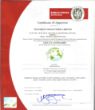
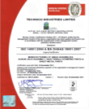
Technico Industries : Synopsis
Technico At a Glance
Business and Certification
Establishment | 1972
Head Quarters | Gurgaon, Haryana
Sales | 2,852 Million INR ( FY 17-18 )
Employees | ~ 1,100
Plants | Mother Plant – Bawal, Haryana Other Plants – Bangalore, Chennai & Gujarat Technology Centre – Manesar, Haryana
Clients | Maruti Suzuki India Limited Suzuki Motors Gujarat Renault Nissan Toyota Kirloskar Motors India Tata Motors Mahindra & Mahindra Isuzu Motors India & Other OEM’s Shiroki Technico India
Business | Automotive parts Door Hinges, Hood Hinges, Back door Hinges, Trunk Lid Hinge Engine Mounting & Axle parts BIW ( Body ) parts Screw Jack (Pentograph) Brake & Clutch Pedal Other Stamping Components
Certificates
ISO / TS 16949 : 2009 (NOW IATF)
ISO 14001 : 2004
OHSAS : 18001 : 2007

Slide 3




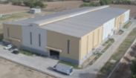

Technico Industries - Facilities
Manesar
(Plant -6)
Technology Centre
(Design & Development)
Establishment | 2009
Area | 24,300 square meter
Products | Hinges, Screw Jack Assembly, Body Parts, Brake & Clutch Pedal Assembly & Other Stamping Components.
Facilities | Press Shop ( Progressive & Tandem), Welding, Plating, Assembly Shop, Standard Room
Gujarat-2
(Plant -5)
Bawal
(Mother Plant -1)
Establishment | 2017
Area | 13,750 square meter
Facilities | Surface Treatment
Establishment | 2010
Area | 3,800 square meter
Products | Window Regulator, Hinges
Facilities | Assembly
Bengaluru
(Plant -2)
Gujarat – 1
(Plant -4)
Establishment | 2010
Area | 3,300 square meter
Products | Hinges
Facilities | Assembly
Establishment | 2017
Area | 45,000 square meter
Products | Same as Bawal Plant
Facilities | Press Shop ( Progressive & Tandem), Welding, Assembly Shop
Chennai
Plant -3

Slide 4
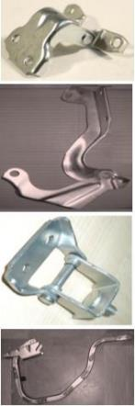



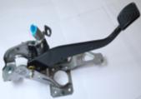
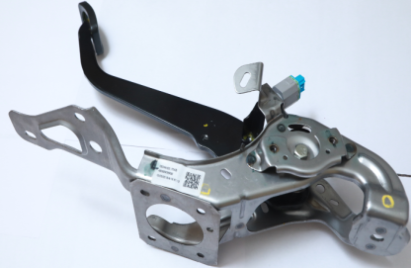



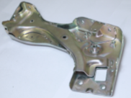
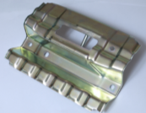


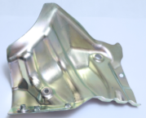
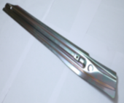
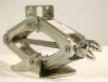
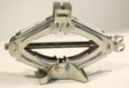
Technico Product Portfolio
Hinges
Stamping Parts ( Chassis, Axle, BIW, Power train)
Brake Pedal & Clutch Pedal
High Tensile BIW & Seat Frame Parts
Screw Jack Assembly

Slide 5
Technico Strength
Concept Design to Product Design and validation with CAE Analysis.
In house Tool Design & Manufacturing (Progressive, Tandem and Fine Blanking Dies) up to 980 Tensile Tooling.
High Tensile material up-to 980 Tensile Strength.
Progressive & Fine Blanking Stamping Capability & Facility.
In-house Zinc Plating & Other Facilities.
In-house Testing and validation Facility.

Slide 6

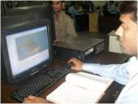
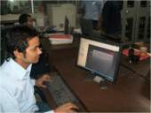
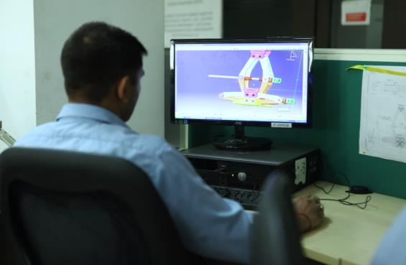
Design Facility : Part & Tool Design
Product Design Capability | Software used | Purpose of software | Photograph
Solid Modeling | CATIA V5-R-25 | 3D & 2D Generation
 | UG-NX-9.0, AutoCAD 2016 | 3D & 2D Generation
CAE Analysis | Altair-Hyper-Works 13.0 | Static & Dynamic Analysis & Blank Development
 | Ideas Simulation & CATIA Kinematic | Kinematic Analysis

Slide 7
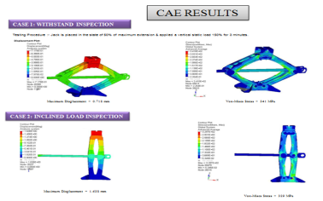
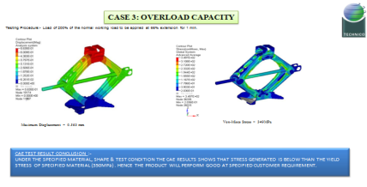

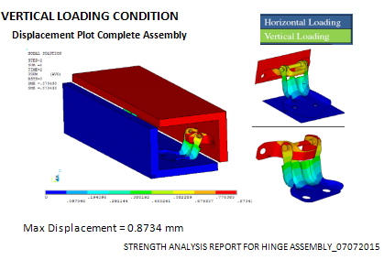
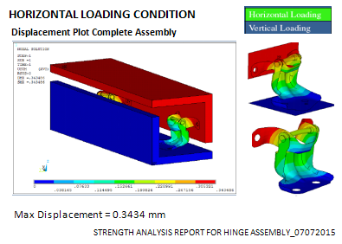
Design Capability : CAE Analysis

Slide 8
Technico Strength
Concept Design to Product Design and validation with CAE analysis.
In house Tool Design & Manufacturing (Progressive, Tandem and Fine Blanking Dies) up to 980 tensile tooling.
High Tensile material up-to 980 Tensile Strength.
Progressive & Fine Blanking Stamping Capability & Facility.
In-house Zinc Plating & Other Facilities.
In-house Testing and validation Facility.

Slide 9
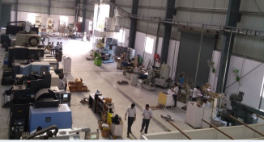
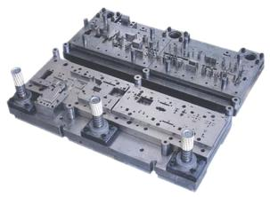
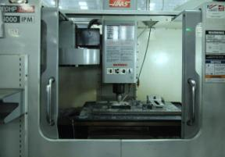
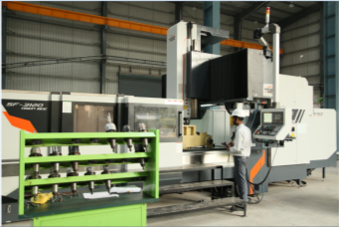
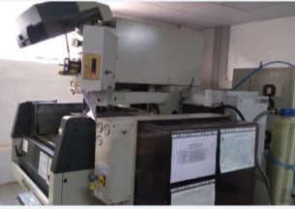
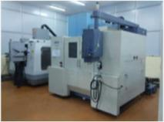
Technology Centre ( Manesar ) : In-house Tool Room
  We have state of the Art tooling facility with in-house Tool manufacturing facility for Tandem, Progressive & Fine Blanking Dies catering all customer requirement .
CNC VERTICAL MACHINING CENTER
VERTICAL MACHINING CENTER
DOUBLE COLOUM VERTICAL MILLING MACHINE WITH UNIVERSAL HEAD
CNC WIRE CUT MACHINES

Slide 10
In-house Tool Room : Facility
S.NO | MACHINE NAME
1 | TRIAL PRESSES WITH CAPACITY 110T, 160T, 200T, 400T & 600T.
2 | WIRE CUT EDM - 3 NOS.
3 | VERTICAL MILLING CENTRE - 6 NOS.
4 | M1TR MILLING MACHINES - 3 NOS.
5 | RADIAL DRILLING MACHINES - 2 NOS.
6 | LATHE MACHINE -1 NO.
7 | SURFACE GRINDING MACHINES - 4 NOS.
8 | DRILLING MACHINES - 3 NOS.
9 | EOT CRANE - 2 NOS.
10 | FORK LIFTER -1 NO.

Slide 11
Technico Strength
Concept Design to Product Design and validation with CAE Analysis.
In house Tool Design & Manufacturing (Progressive, Tandem and Fine Blanking Dies) up to 980 Tensile Tooling.
Stamping of High Tensile material up-to 980 Tensile Strength.
Progressive & Fine Blanking Stamping Capability & Facility.
In-house Zinc Plating & Other Facilities.
In-house Testing and validation Facility.

Slide 12
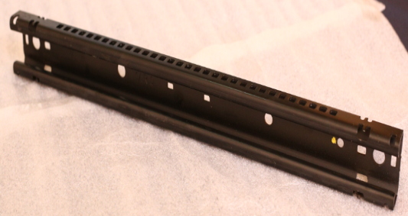
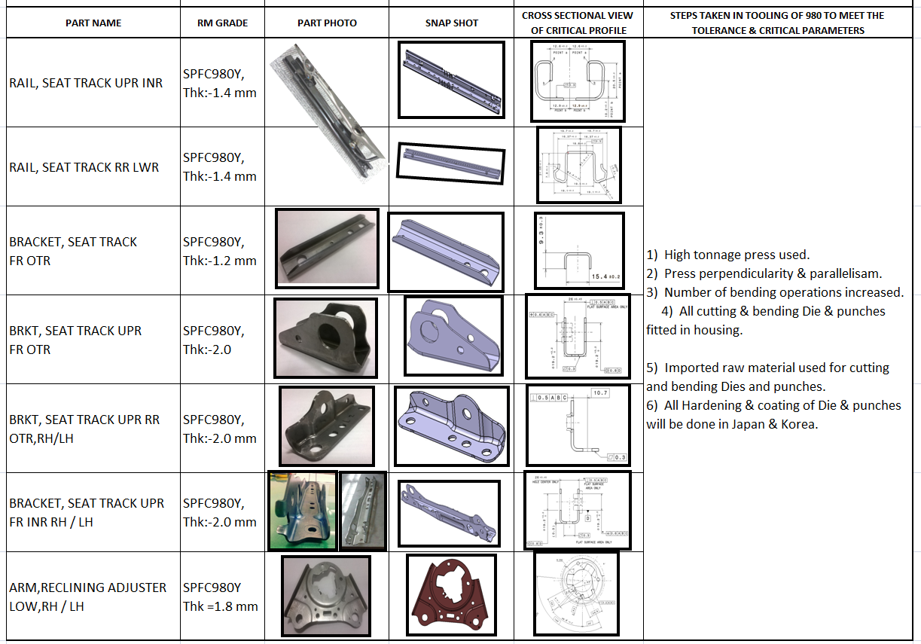
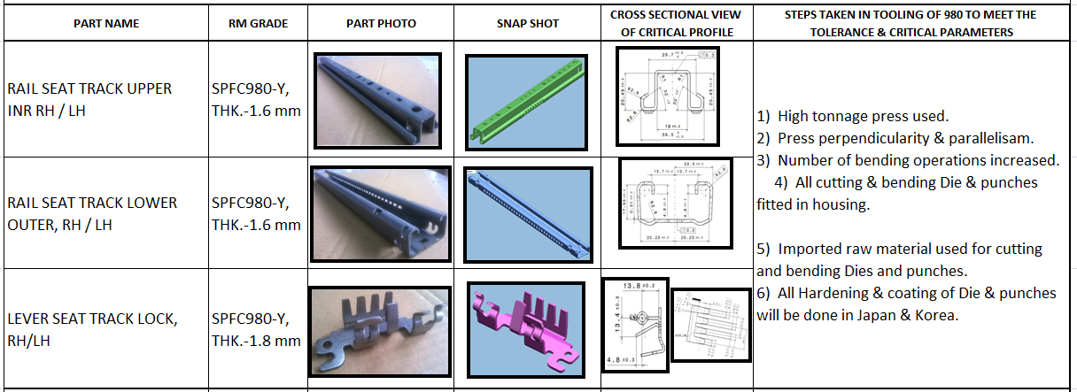
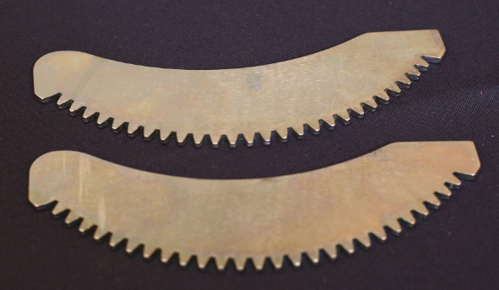
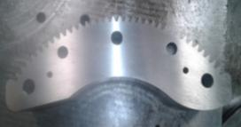
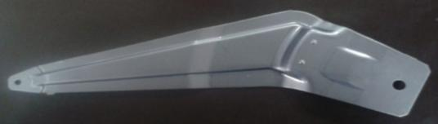
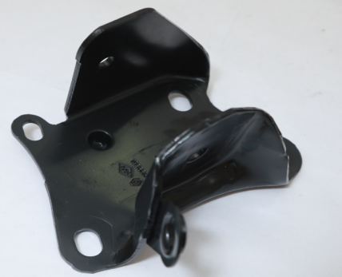
High Tensile Strength Parts Manufacturing
Component | Material | Part Picture
Seat Slider Rail and Riser & other parts | SPFC980
Gear Sectors for Window Regulators (Fine Blanking Components) | SPFH780
Window Regulator Arm and Brackets A-Point Bracket | SPFH590

Slide 13
Technico Strength
Concept Design to Product Design and validation with CAE Analysis.
In house Tool Design & Manufacturing (Progressive, Tandem and Fine Blanking Dies) up to 980 Tensile Tooling.
High Tensile material up-to 980 Tensile Strength.
Progressive & Fine Blanking Stamping Capability & Facility.
In-house Zinc Plating & Other Facilities
In-house Testing and validation Facility.

Slide 14
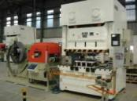
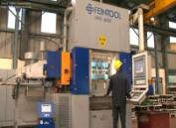
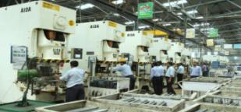
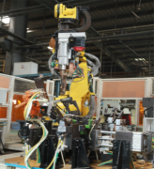
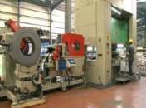
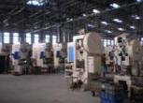
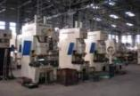
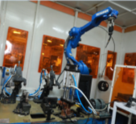
Manufacturing Facility: Bawal Plant
Press Shop-Progressive
Press Shop-Tandem
Welding Shop
160 T > AIDA
250 T >AIDA
300 T > AIDA
400 T > SEYI
600T > SEYI
630T > AIDA
400T > FEINTOOL (Fine Blanking )
Total Progressive Press : 12 Nos
(Including 1 fine blanking)
MECHANICAL AND PNEUMATIC PRESSES
PRESS TONNAGE FROM 30 TONS TO 500 TONS
Total Mechanical & Pneumatic Press more than 50 No’s
PROJECTION WELDING
MIG ROBOTIC WELDING
SPOT ROBOTIC WELDING

Slide 15
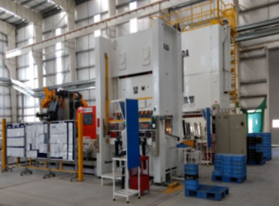
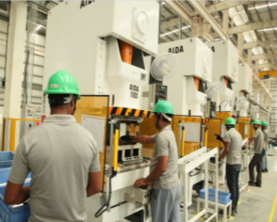
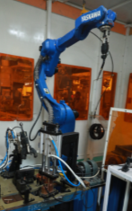
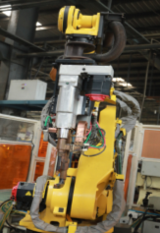
Manufacturing Facility: Gujarat Plant (Phase I)
Press Shop-Progressive
Press Shop-Tandem
Welding Shop
110 T x 2 AIDA
160 T x1 AIDA
200 T x 5 AIDA
300 T x 1 SEYI
500 T x 1 SEYI
300 T x 1 AIDA
630T x 1 AIDA
PROJECTION WELDING
SPOT ROBOTIC WELDING
MIG ROBOTIC WELDING
Total Progressive Press : 2 No’s
Total Tandem Press : 10 No’s

Slide 16
Technico Strength
Concept Design to Product Design and validation with CAE Analysis.
In house Tool Design & Manufacturing (Progressive, Tandem and Fine Blanking Dies) up to 980 Tensile Tooling.
High Tensile material up-to 980 Tensile Strength.
Progressive & Fine Blanking Stamping Capability & Facility.
In-house Zinc Plating & Other Facilities
In-house Testing and validation Facility.

Slide 17
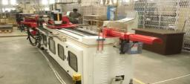
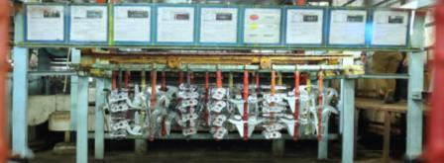
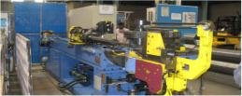

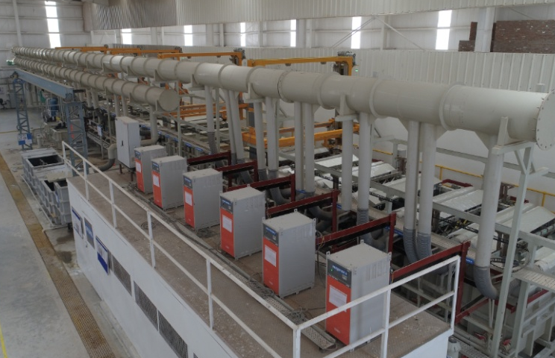

Manufacturing Facility : Plating Plant & Other Facilities
5 Axis CNC Tube Bending Machine
Plating Plant Bawal
The plant is Plc Controlled Automatic Zinc Plating Plant & is 100% Cr3+ Elv Compliant) with capacity of 70 Million Sq inch/month, it is equipped with an Effluent Treatment Plant For Effective Disposal Of Effluents Generated During The Process
Roll Forming Machine
Plating Plant Gujarat
Suzuki Approved Plating Plant
Zinc plating plant equipped with Auto Dozing for chemicals with SCADA control
Nodal point for all surface finishes for Suzuki and Other OE vendors
Equipped with Effluent Treatment Plant with Zero discharge
Environment friendly plant

Slide 18
Technico Strength
Concept Design to Product Design and validation with CAE Analysis.
In house Tool Design & Manufacturing (Progressive, Tandem and Fine Blanking Dies) up to 980 Tensile Tooling.
High Tensile material up-to 980 Tensile Strength.
Progressive & Fine Blanking Stamping Capability & Facility.
In-house Zinc Plating & Other Facilities
In-house Testing and validation Facility.

Slide 19
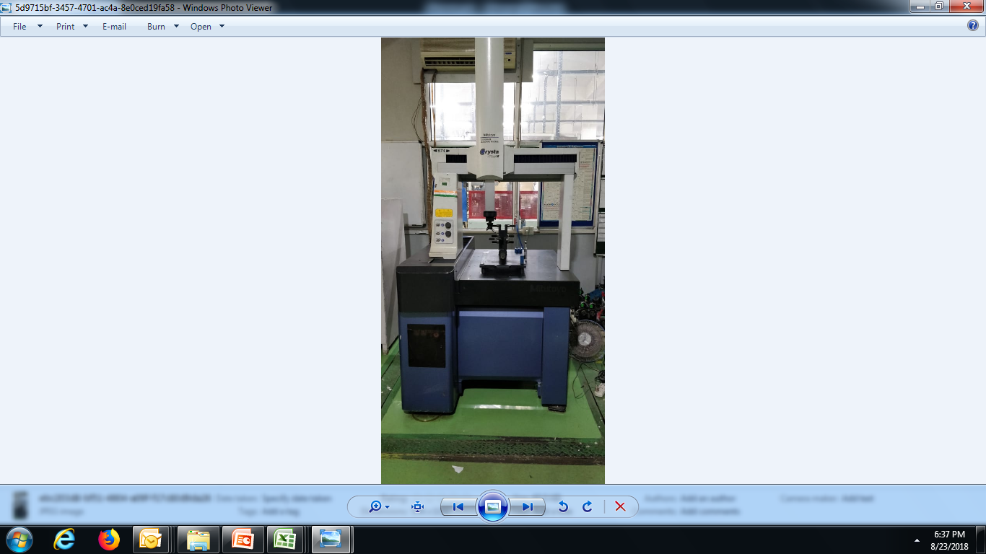
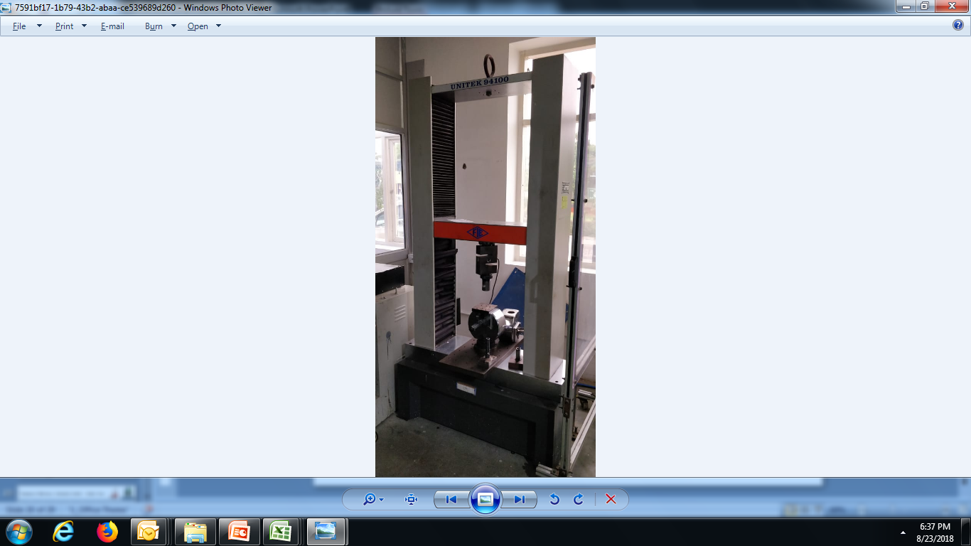




Testing & Validation Facility
STANDARD AND INSPECTION ROOM ( BAWAL AND GUJARAT )
    COORDINATE MEASURING MACHINE (CMM),
    HARDNESS TESTER,
    PROFILE PROJECTOR AND CALIBRATED GAUGES.
    STEARIO ZOOM MICROSCOPE
    STRENGTH TESTING M/C UTM
TEST CENTER ( TECHNOLOGY CENTRE MANESAR )
    CORROSION TEST
    ENDURANCE TEST
    PERFORMANCE TEST
    RIGIDITY TEST
    DURABILITY TEST
    VIBRATION TEST
    SLAM TEST
    JACK TESTING MACHINE

Slide 20
Technico Industries Ltd
Customer Wise,
Region Wise
&
Commodity Wise Sales

Slide 21


Presence of Technico in Domestic Market : Model Wise
OEM | MODEL | Picture | Hood Hinge | Door Hinge | Back / Trunk Hinge | Screw Jack | Axle /BIW / Seat / Transm~ | Pedal (Clutch & Brake)
 | Alto-800 |  | √ | √ | √
 | Eeco |  | √ |  | √ |  | √
 | Alto-K10 |  | √ | √ | √
 | Dzire |  | √ | √ | √ | √
 | Omni |  |  |  |  |  | √
 | Gypsy |  |  |  |  |  | √
 | Celerio |  |  | √ | √ |  | √
 | Ertiga |  | √ | √ | √ | √
 | S Cross |  |  | √ | √
 | Ciaz |  | √ | √ | √ | √
 | Baleno |  |  | √ | √ |  | √
 | Brezza |  |  | √ | √ |  | √
 | Ignis |  |  | √ | √ |  | √

Slide 22















Presence of Technico in Domestic Market : Model Wise
OEM | MODEL | Picture | Hood Hinge | Door Hinge | Back / Trunk Hinge | Screw Jack | Axle /BIW / Seat / Transm~ | Pedal (Clutch & Brake)
 | Swift |  | √ | √ | √ |  | √
 | Baleno |  |  | √ | √ |  | √
 | Liva |  | √ | √ | √
 | Etios |  | √ | √ | √
 | Corolla |  | √ | √ | √
 | Innova -C |  | √ | √ | √
 | Fortuner |  | √ | √ | √
 | Yaris |  | √ | √ | √
 | Nano |  |  | √ | √
 | Tiago |  | √ | √
 | Nexon |  | √ | √ | √
 | Hexa |  |  | √

Slide 23














Presence of Technico in Domestic Market : Model Wise
OEM | MODEL | PICTURE | Hood Hinge | Door Hinge | Back / Trunk Hinge | Screw Jack | Axle /BIW / Seat / Transm~ | Pedal (Clutch & Brake)
 | Micra |  | √ | √ | √ |  | √
 | Sunny |  | √ | √ | √ |  | √
 | Terrano |  |  |  |  |  | √
 | Pulse |  | √ | √ | √ |  | √
 | Scala |  | √ | √ | √ |  | √
 | Kwid |  | √ | √ | √ |  | √
 | Duster |  |  |  |  |  | √
 | Captur |  | √ | √ | √ |  | √
 | Go |  | √ | √ | √ |  | √
 | Go+ |  | √ | √ | √ |  | √
 | Redigo |  | √ | √ | √ |  | √

Slide 24







Presence of Technico in Domestic Market : Model Wise
OEM | Model | Vehicle | Hood Hinge | Door Hinge | Back / Trunk Hinge | Screw Jack | Axle /BIW / Seat / Transm~ | Pedal (Clutch & Brake)
 | VERITO / VIBE |  |  |  | √
 | XUV-500 |  | √ |  | √
 | KUV-100 |  | √ |  | √
 | TUV-300 |  | √ | √
 | Bolero-R |  | √
 | Jeeto |  |  |  | √
Also future project of Maruti Suzuki, Renault Nissan, Toyota Kirloskar, Tata Motors, M & M are under Development.
Apart from Domestic market, Technico parts are Exported to 19 different countries :-
Brazil
China
Egypt
Indonesia
Japan
Myanmar
Malaysia
Mexico
Philippines
Romania
Russia
France
Spain
Taiwan
Thailand
UK
Vietnam
Turkey
US

Slide 25











Sales : FY 17-18
Commodity Wise
Customer Wise
Location Wise
Major Customers

Slide 26
CSR : Environment Care
Operational Effluent treatment facility for 100 % Effluent treatment.
Treated & reused more than 138 million liters of water up to 2017-18.
Zero hazardous waste discharge in the community drains.
Clean India Initiative by adopting 2 School for providing Toilet and sanitation facility.
Planted more than 3000 trees till date in Bawal Plant.
Distributed 18,000 Food packets up to 2016-17 to poor & home less people near Bawal & Rewari.
Contribution towards sponsoring scholarship to 21 Students, to Ram Sewa Satyanand Trust, a Charitable Trust at Gohana (Sonepat).
Contribution to The Earth Saviours Foundation, Gurgaon, an organisation for poor, destitute and old people.
Endowment towards provision of dual desk to a Govt. School in Vill. Mohammad Pur, Rewari.
Development and maintenance of green belt and plantation of trees in Bawal (Rewari) and Gurgaon.

Slide 27








Customer Accolades & Recognition

Slide 28
Technico Industries Ltd

